Slide 1


Design and constructing a YACC based parser for arithmetic expression
Presented by:
[M Uday Kiran] [192372218]
[CSA1429] [Compiler Design for Industrial Automation]
Date: [20/03/2025]

Slide 2
Introduction
Overview of the project :
1.The project focuses on designing a parser using YACC to analyze and evaluate arithmetic expressions.
2.It ensures correct operator precedence and associativity, converting expressions into structured syntax trees.
Problem statement:
1.Manually parsing arithmetic expressions is error-prone and inefficient, requiring automation.
2.A parser must correctly handle different operators, parentheses, and numeric values while maintaining accuracy.
Purpose of the project:
1.To create an efficient and accurate parser that can process arithmetic expressions automatically.
2.To demonstrate how YACC can simplify syntax analysis and expression evaluation in compiler design.

Slide 3
Objectives
1. Define Clear Goals
Develop a YACC-based parser that correctly processes arithmetic expressions with operator precedence.
Ensure the parser efficiently translates expressions into an abstract syntax tree for further evaluation.
2. Address the Problem Statement
Automate the parsing of arithmetic expressions to eliminate manual errors and inefficiencies.
Implement error handling to detect and report syntax errors in expressions.
3. Expected Outcomes
A fully functional arithmetic expression parser that correctly evaluates different expressions.
Improved understanding of compiler design principles, syntax analysis, and YACC implementation.

Slide 4
Literature Review / Background
1. Summary of Existing Research
Previous research has focused on compiler design, syntax analysis, and parsing techniques, including LL(1) and LR parsers.
YACC has been widely used in developing parsers for arithmetic expressions, demonstrating its effectiveness in automating syntax analysis.
2. Theoretical Foundation
Context-Free Grammars (CFG) and parsing algorithms form the basis of expression parsing, ensuring syntactic correctness.
Operator precedence and associativity principles are crucial for designing grammars that correctly interpret arithmetic operations.
3. Research Gap
Many existing implementations focus on theoretical parsing but lack practical demonstrations using YACC for real-world applications.
Limited research explores optimizing YACC-based parsers for efficiency, error handling, and extensibility in compiler design.

Slide 5
Methodology
1. Tools & Frameworks Used
YACC (Yet Another Compiler Compiler): Used for generating the parser to analyze arithmetic expressions.
Lex (Lexical Analyzer): Complements YACC by tokenizing the input expressions before parsing.
2. Development Approach
The project follows a compiler design approach, starting with lexical analysis, followed by syntax analysis using YACC.
A bottom-up parsing technique (LALR(1)) is used, ensuring efficient and accurate expression evaluation.
3. Data Collection
Sample arithmetic expressions with different complexities (e.g., 3+5*2, (4-1)/3) are used for testing.
Error cases (e.g., 3++5, */2) are collected to evaluate the parser’s robustness in handling syntax errors.

Slide 6
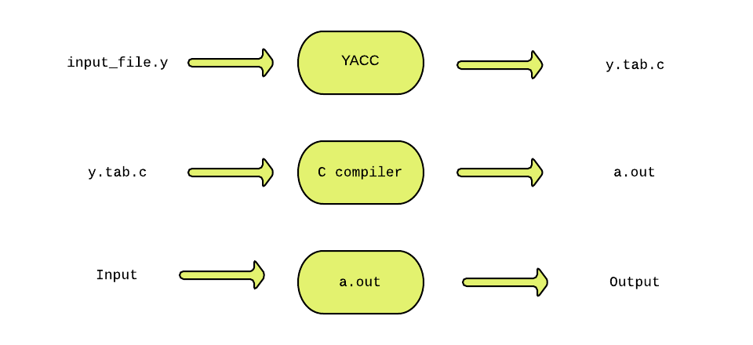
System Design / Architecture
Flowcharts & block diagrams

Slide 7
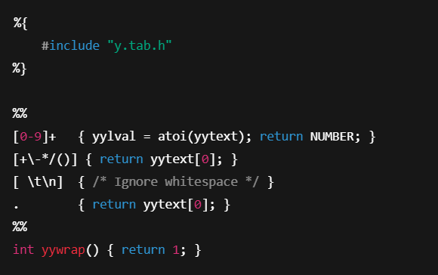
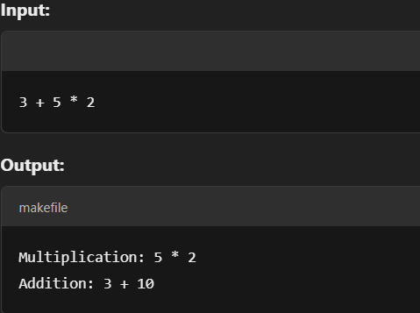
Implementation
Key features & functionalities:
Efficient Parsing & Operator Precedence – Uses YACC's LALR(1) parsing to correctly handle +, -, *, /, and parentheses with proper precedence and associativity.
Lexical Analysis & Error Handling – Lex tokenizes numbers and operators, while YACC detects and reports syntax errors.
Abstract Syntax Tree (AST) Generation – Converts expressions into structured trees for accurate evaluation.
Code snippets :

Slide 8
Results & Discussion
Outcomes of the project:
Successful Parsing of Arithmetic Expressions – The YACC-based parser correctly handles expressions with +, -, *, /, and parentheses while maintaining operator precedence and associativity.
Error Detection & Handling – The parser identifies syntax errors and provides meaningful error messages.

Slide 9
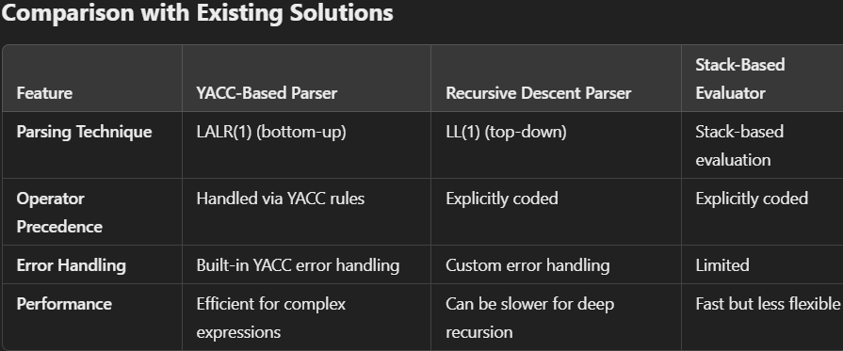

Slide 10
Challenges & Limitations
Issues Faced During Development:
Ambiguity in Grammar – Ensuring correct operator precedence and associativity without conflicts in YACC.
Error Handling Complexity – Implementing meaningful error messages for incorrect expressions.
Debugging Lex & YACC Integration – Identifying and resolving token mismatches between Lex and YACC.
Possible Constraints:
Limited Extensibility – The parser is designed for arithmetic expressions and may require significant modifications for other languages.
Dependency on LALR(1) Parsing – YACC handles only LALR(1) grammars, limiting flexibility for more complex constructs.
Performance Considerations –While efficient, larger expressions may require optimizations for faster evaluation.

Slide 11
Future Scope
Enhancements or Improvements
Support for Advanced Arithmetic Operations – Add operators like exponentiation (^), modulus (%), and bitwise operations.
Improved Error Handling – Implement more informative error messages with suggestions for correction.
Performance Optimization – Optimize the parsing algorithm for handling complex expressions more efficiently.
How This Project Can Be Extended Further
Integration with Programming Languages – Embed the parser in a compiler or interpreter for scripting languages.
Graphical User Interface (GUI) Development – Create a calculator application with real-time expression evaluation.
Abstract Syntax Tree (AST) Implementation – Utilize AST for advanced optimizations like constant folding and algebraic simplifications.

Slide 12
Conclusion
1. Summary of the Project :
Developed a YACC-based parser that efficiently processes arithmetic expressions while maintaining correct operator precedence and associativity.
Integrated Lex for tokenization and YACC for syntax validation, ensuring structured parsing and error handling.
2. Key Takeaways :
Parsing automation with YACC simplifies grammar handling and enhances error detection.
The project provides a foundation for future enhancements, such as AST-based optimizations, extended operator support, and GUI integration.

Slide 13
References
Johnson, S. C. (1975). Yacc: Yet Another Compiler-Compiler. Bell Laboratories.
Levine, J. R., Mason, T., & Brown, D. (1992). Lex & Yacc. O'Reilly Media.
Levine, J. R. (2009). Flex & Bison. O'Reilly Media.
Aho, A. V., Lam, M. S., Sethi, R., & Ullman, J. D. (2006). Compilers: Principles, Techniques, and Tools (2nd ed.). Addison-Wesley.
Holub, A. I. (1990). Compiler Design in C. Prentice Hall.

Slide 14
Thank You!!!

